Slide 1
Capstone Project (DAP)
A PowerBI Dashboard

Slide 2
Content
Introduction
Data Cleaning
Data Visualization (PowerBI)
Conclusion

Slide 3
Introduction
An organization's or a group's key metrics can be kept on a dashboard, which is a consolidated platform.
When done effectively, it can serve as a company's main information source. Dashboards are useful for tracking an organization's performance and boosting productivity.
This project presents a getInnotized analytical dashboard solution. The dashboard provides streamlined data (sales,trend analysis month on month etc) that may affect decision-making in the future for the organization's growth.

Slide 4
Data Cleaning
Data cleaning is the process of detecting and correcting inaccurate records in your dataset
In this project, the data was cleaned with both python and excel powerquery
Some data modification performed are;
Handling NAN values
Deleting Blank rows
Correcting dataypes
Merging sheets from different sources into one dataframe

Slide 5
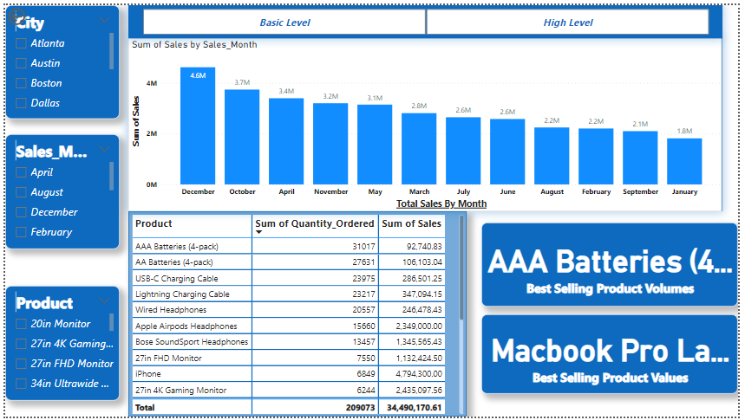
Dashboard Presentation

Slide 6
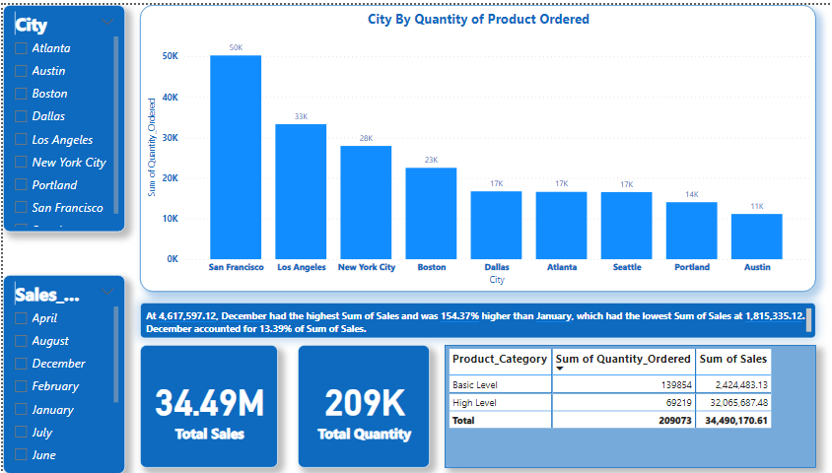
Dashboard Presentation

Slide 7
Conclusion
Good visualized data presentation makes an organization effective and is also instrumental in decision making.
Therefore data accuracy is very essential when building dashboards.

Slide 8

Thank You
Team Autumn
Group Members
Winifred Kwakye
David Tetteh Akoto
Lihla Saisi Shiribwa

